Slide 1
Chapter 13
Binary Input/Output
Objectives
❏ To understand the differences between text and binary files
❏ To write programs that read, write, and/or append binary files
❏ To be able to detect and take appropriate action when file errors occur
❏ To be able to process files randomly
❏ To be able to create text files from binary files and vice versa
❏ To understand and be able to implement file merges
❏ To understand and be able to implement the classic sequential file update

Slide 2
13-1 Text versus Binary Streams
In this section, we compare and contrast text streams versus binary streams.
Topics discussed in this section:
Text and Binary Files
Differences between Text and Binary Files
State of a File
Opening Binary Files
Closing Binary Files

Slide 3
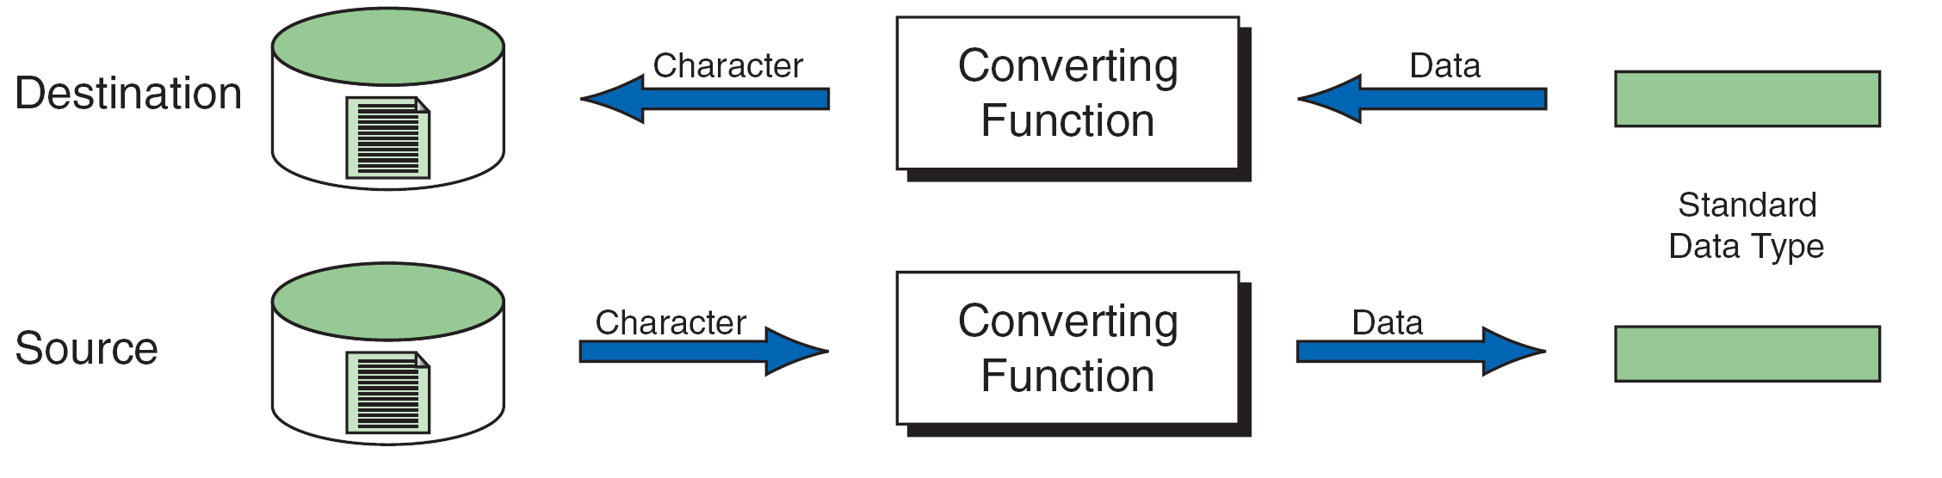
FIGURE 13-1 Reading and Writing Text Files

Slide 4
Note
Formatted input/output, character input/output, and string input/output functions can be used only with text files.

Slide 5
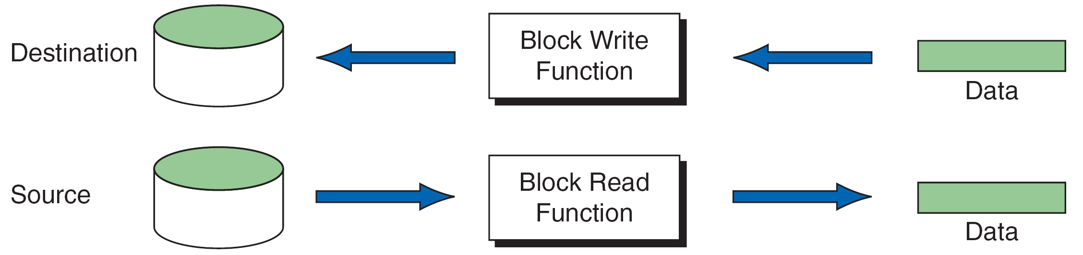
FIGURE 13-2 Block Input and Output

Slide 6
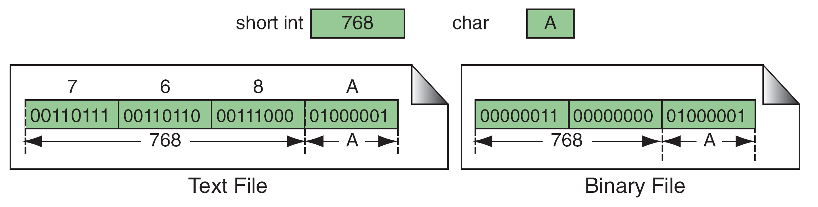
FIGURE 13-3 Binary and Text Files

Slide 7
Note
Text files store data as a sequence of characters; binary files store data as they are stored in primary memory.

Slide 8
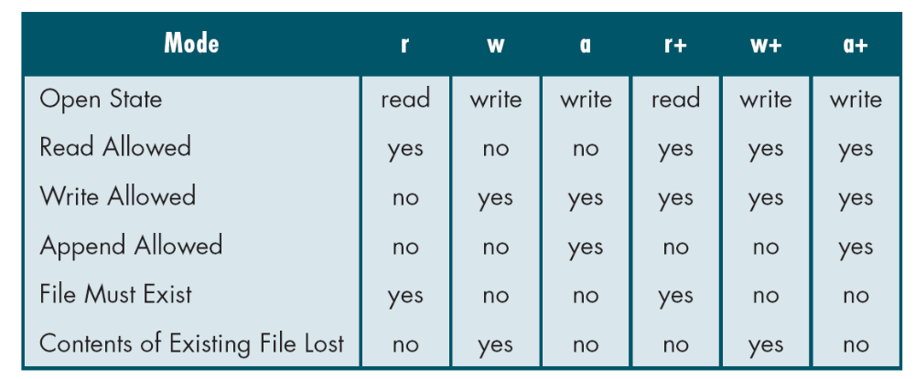
Table 13-1
File Modes

Slide 9
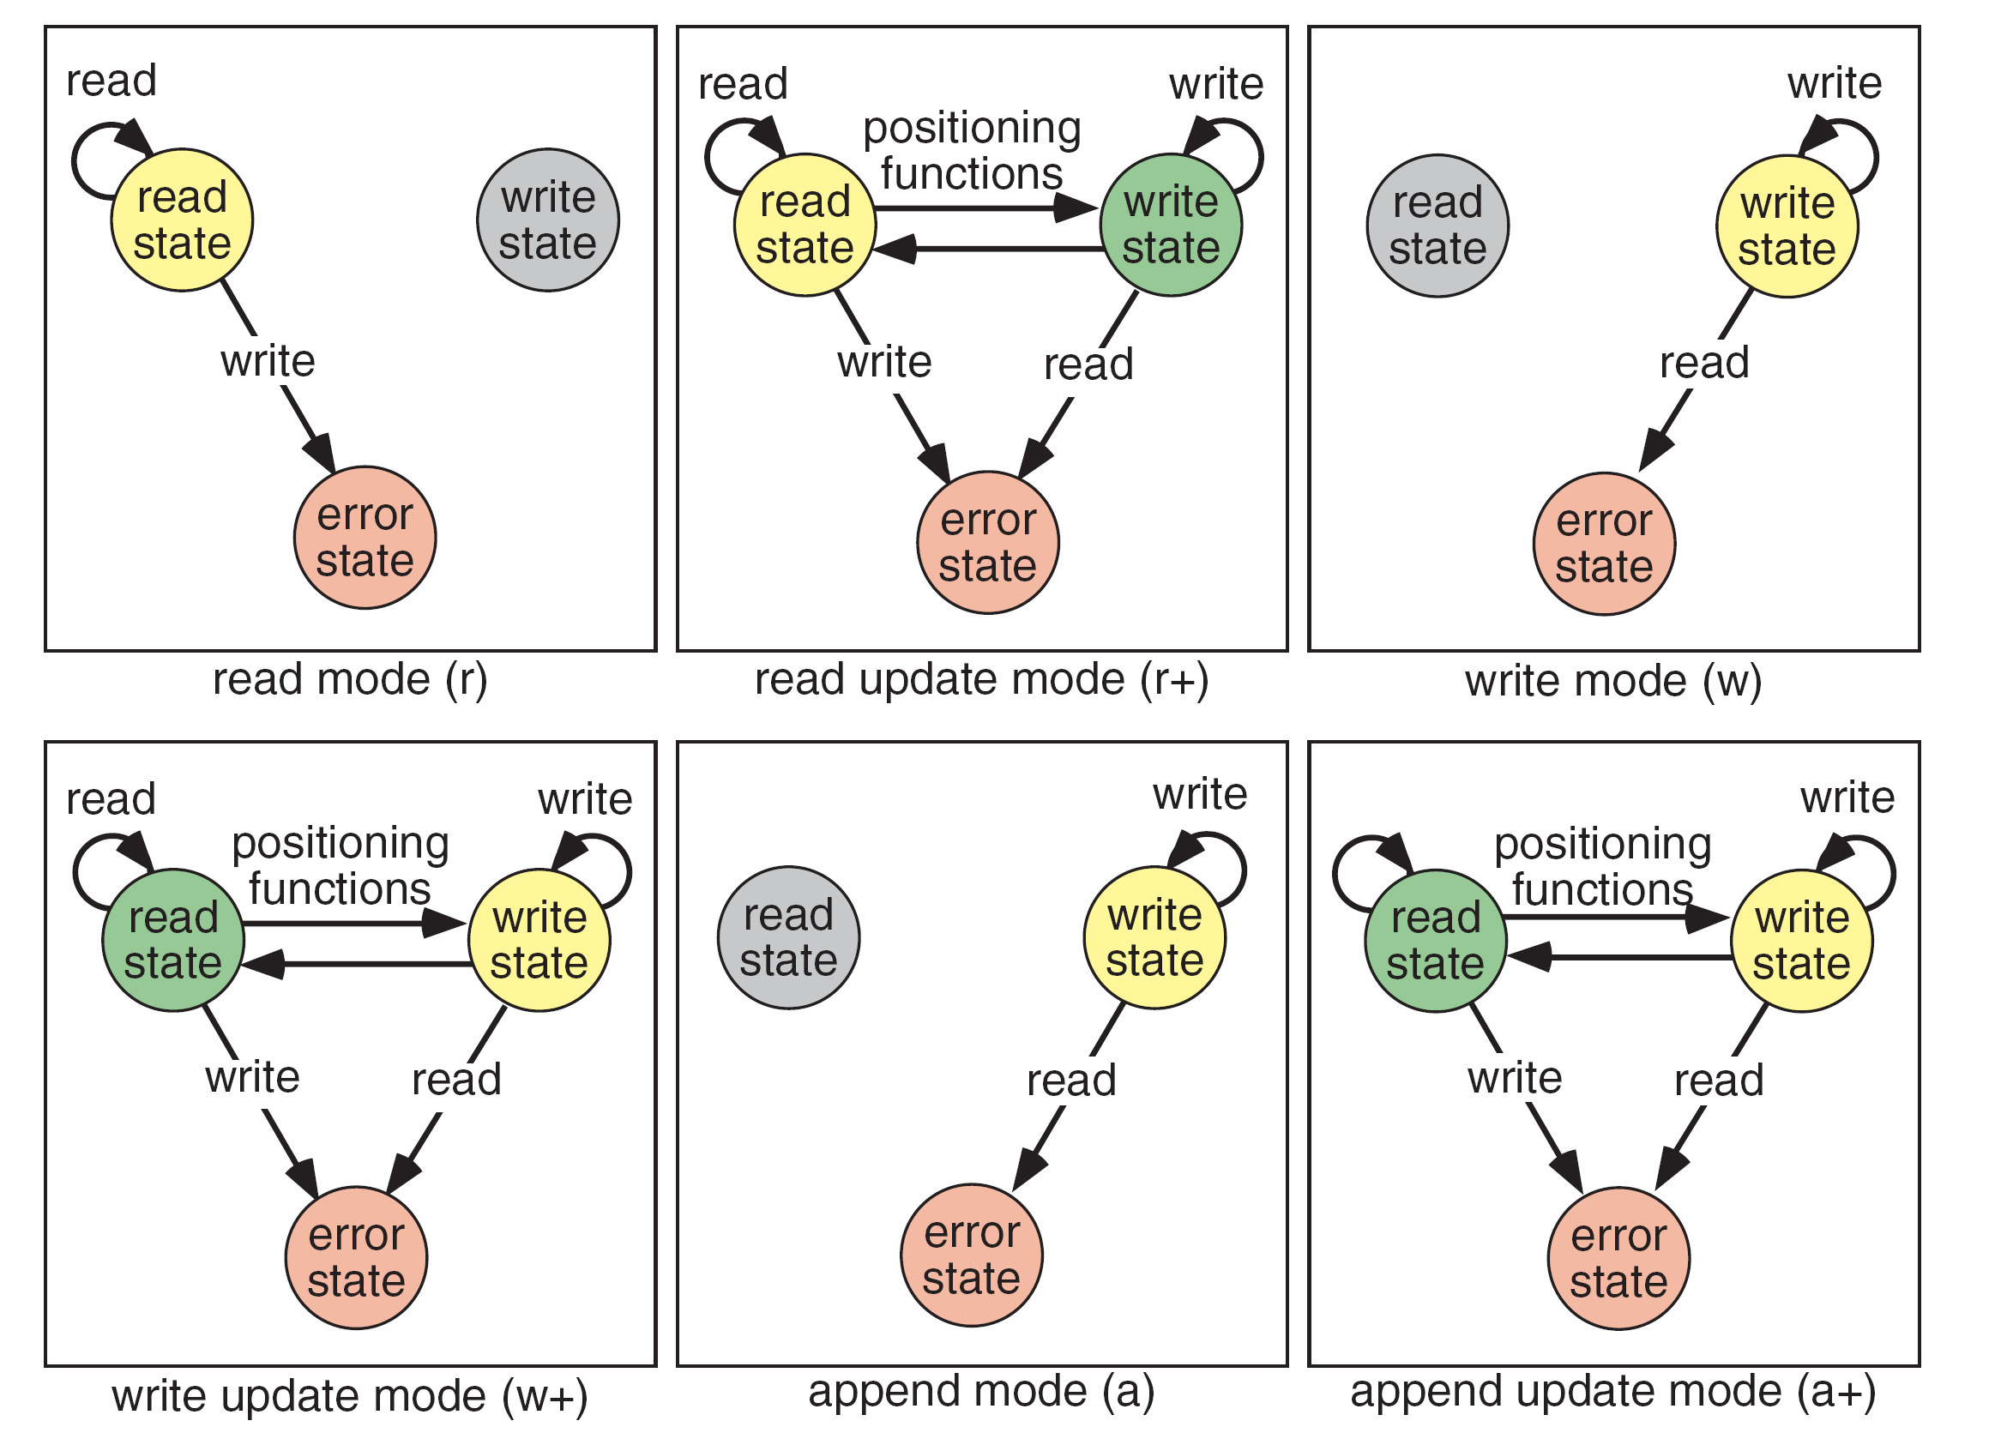
FIGURE 13-4 File States

Slide 10
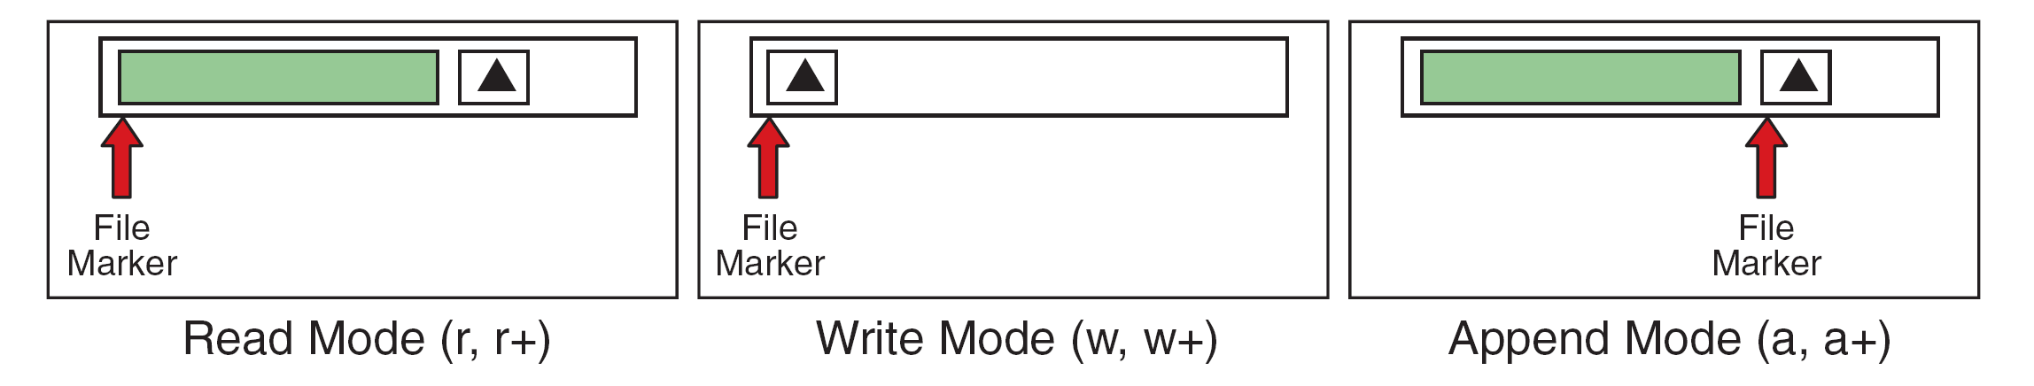
FIGURE 13-5 File-Opening Modes

Slide 11
13-2 Standard Library Functions
for Files
C has eight categories of standard file library functions. We have already discussed the first four in Chapter 7 and Chapter 11. We discuss the other four categories, which are more related to binary files, in this section.
Topics discussed in this section:
Block Input/Output Functions
File Status FunctionsComments
Positioning Functions
System File Operations

Slide 12
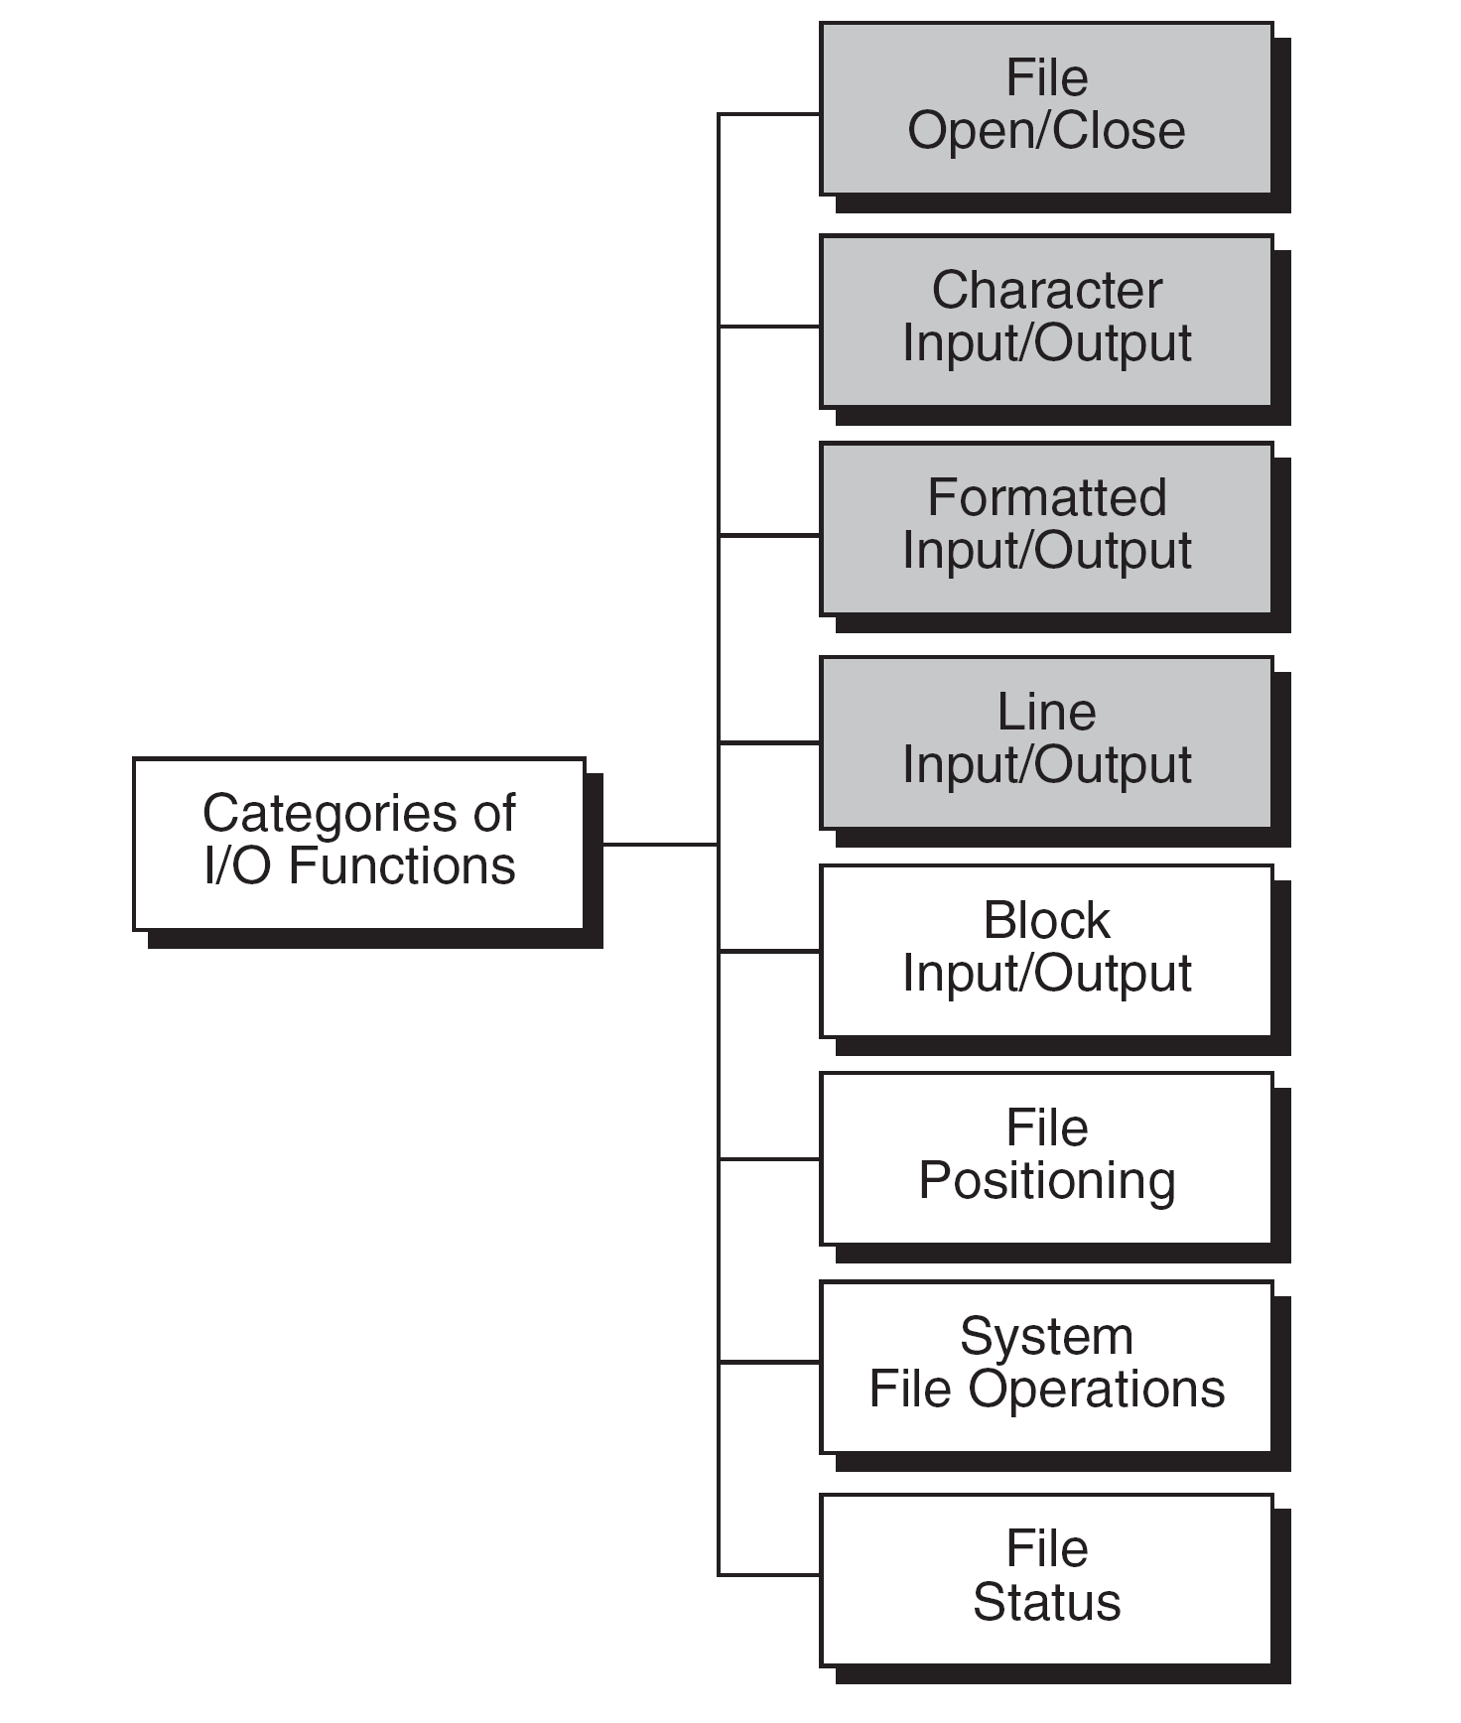
FIGURE 13-6 Types of Standard Input/Output Functions

Slide 13
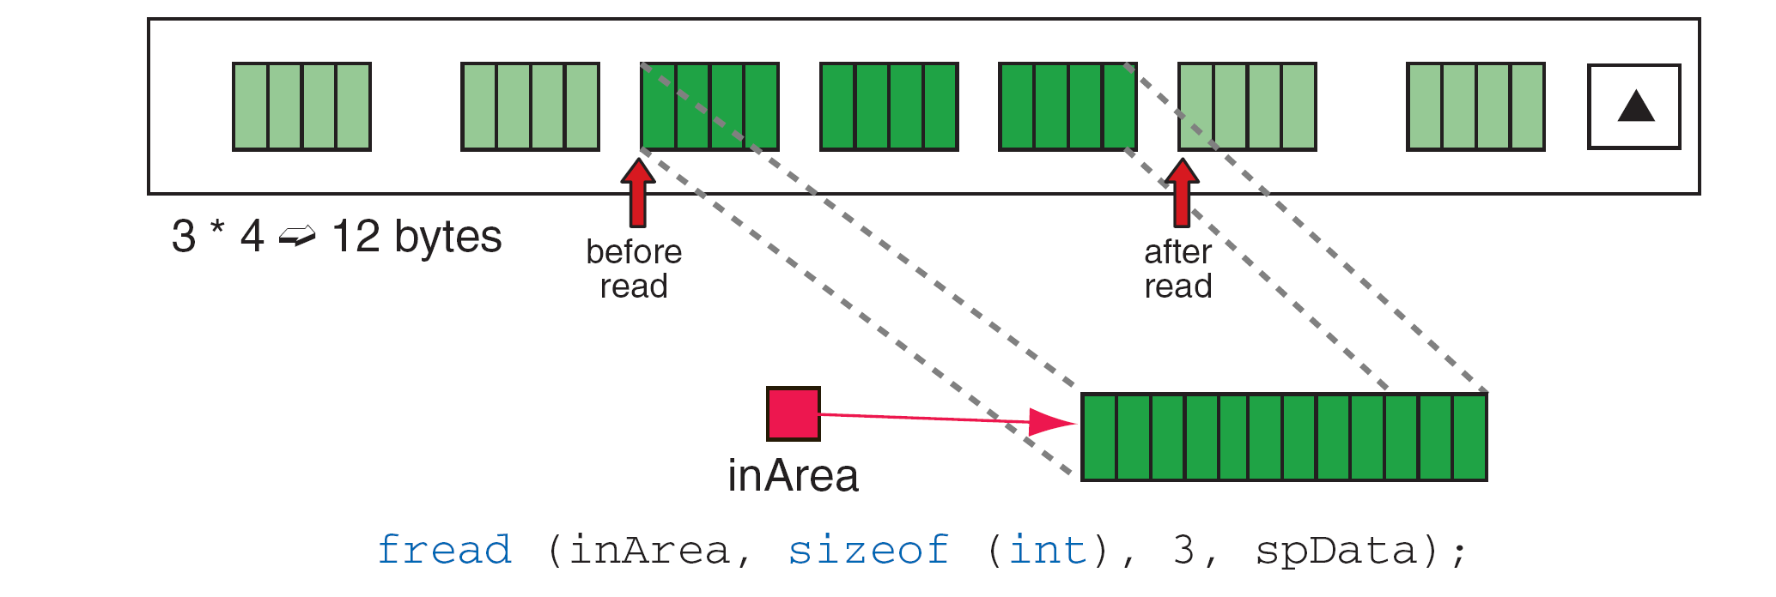
FIGURE 13-7 File Read Operation

Slide 14
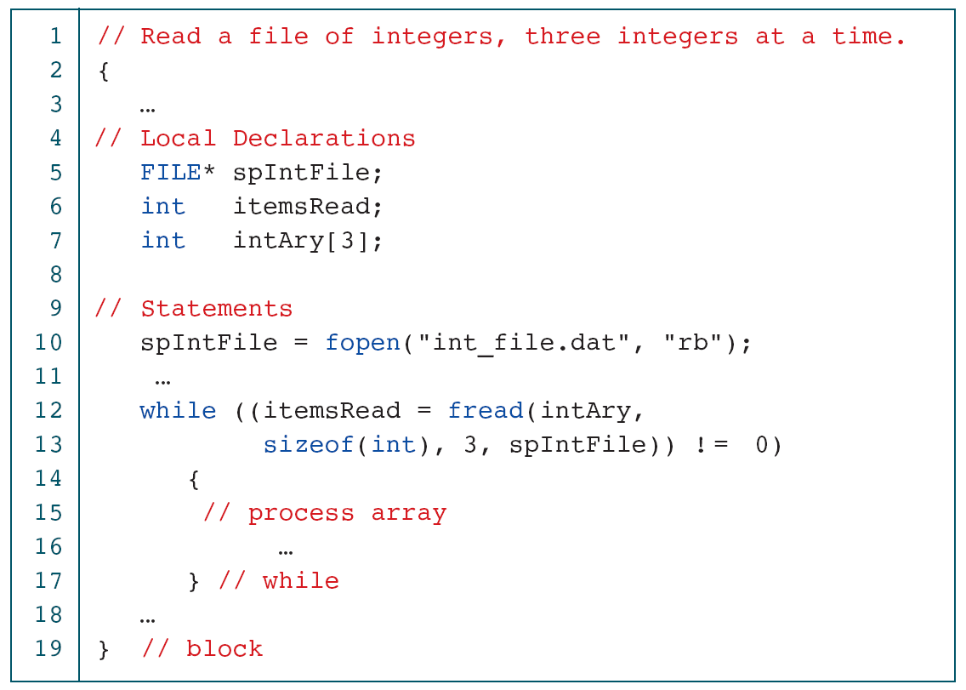
PROGRAM 13-1
Read File of Integers

Slide 15
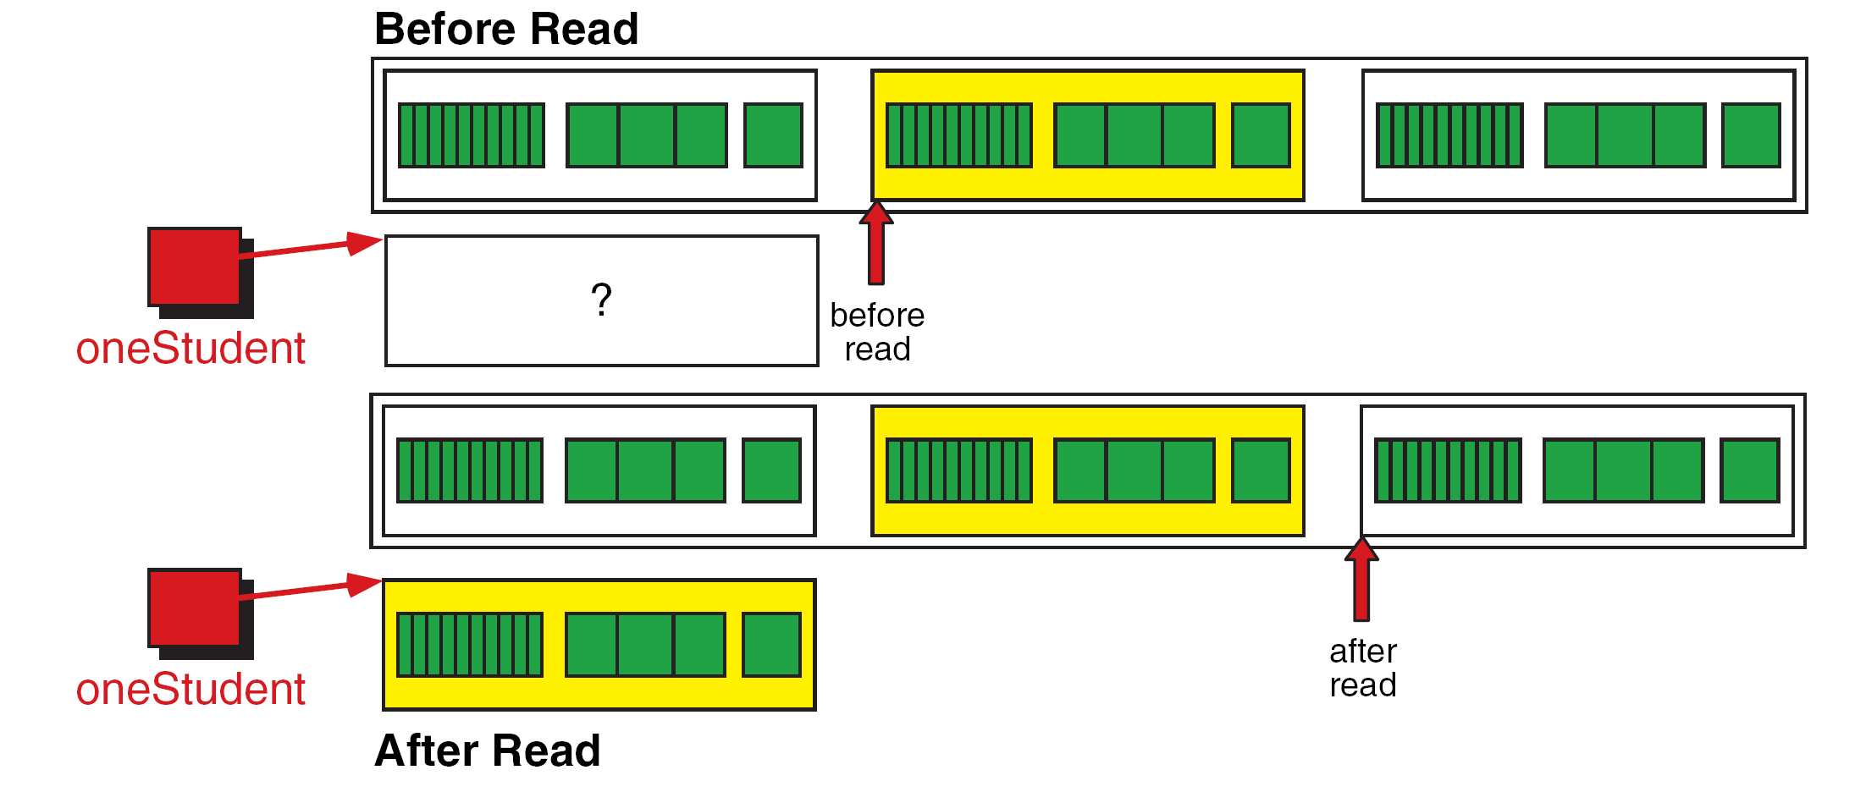
FIGURE 13-8 Reading a Structure

Slide 16
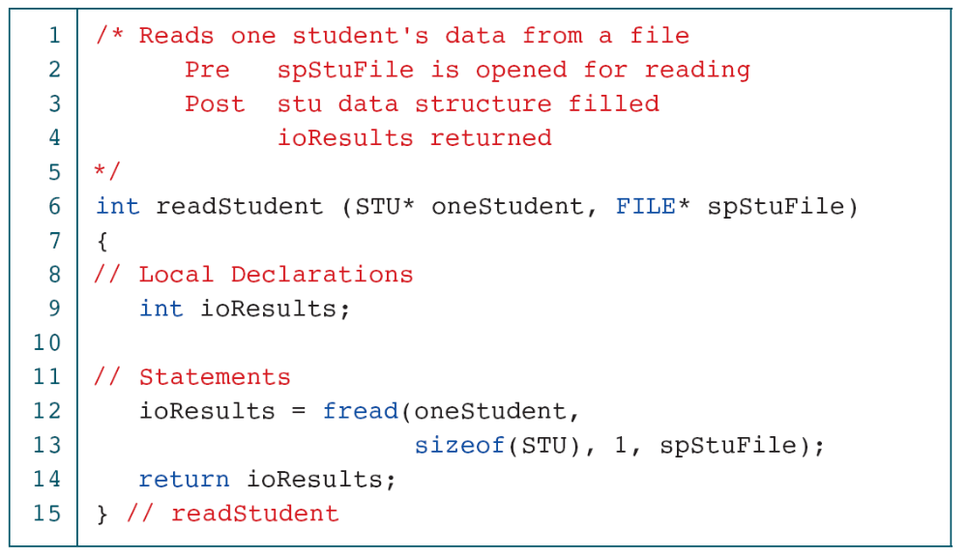
PROGRAM 13-2
Read Student File

Slide 17
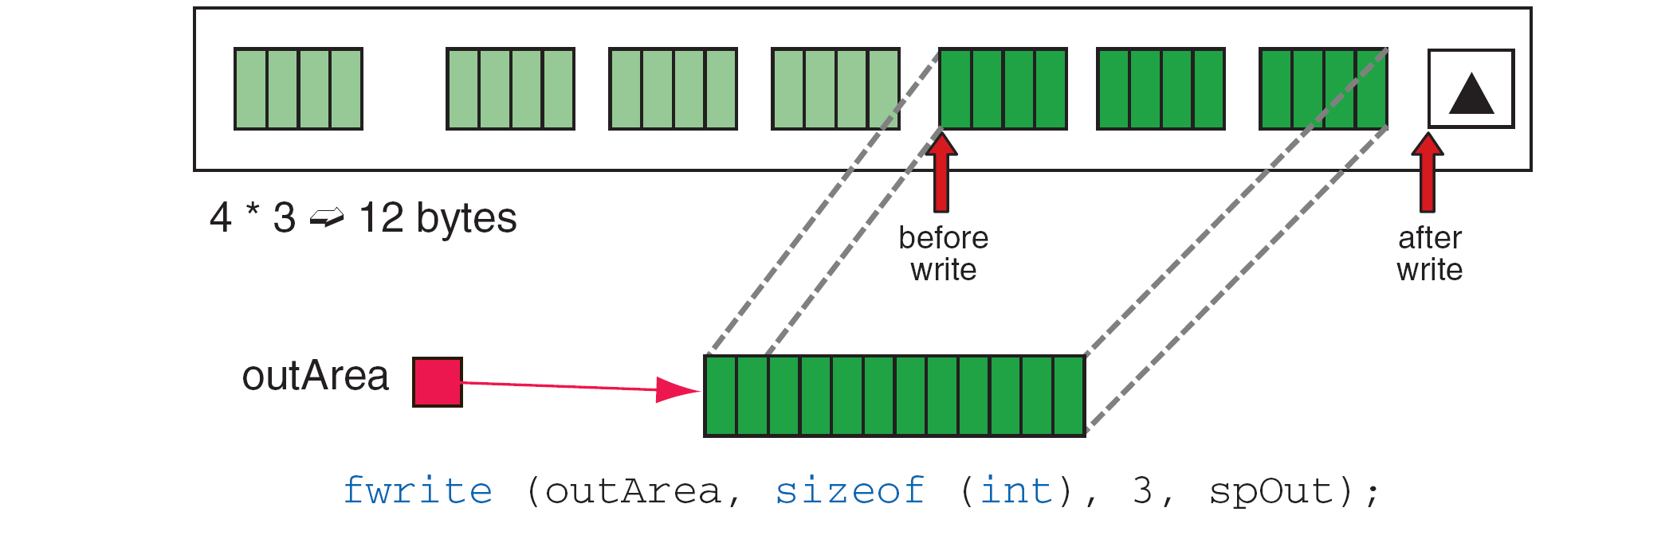
FIGURE 13-9 File Write Operation

Slide 18
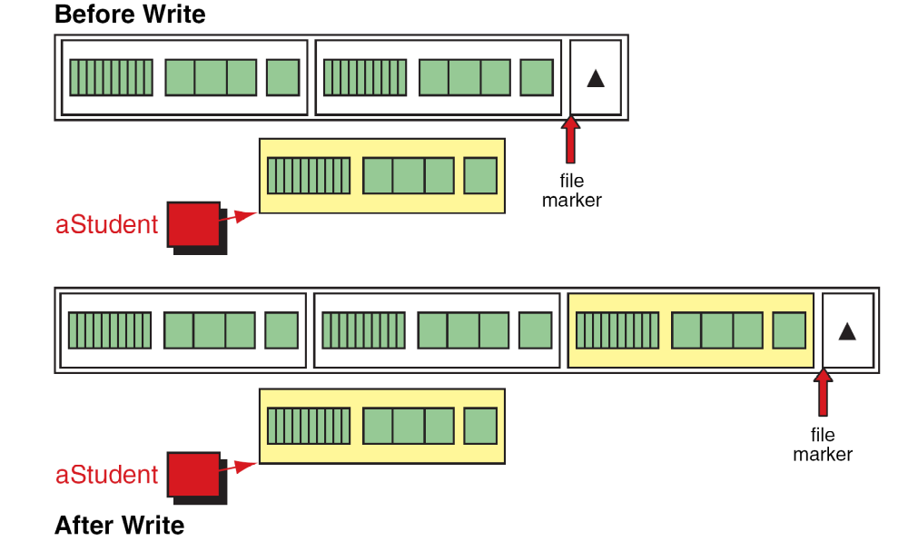
FIGURE 13-10 Writing a Structure

Slide 19
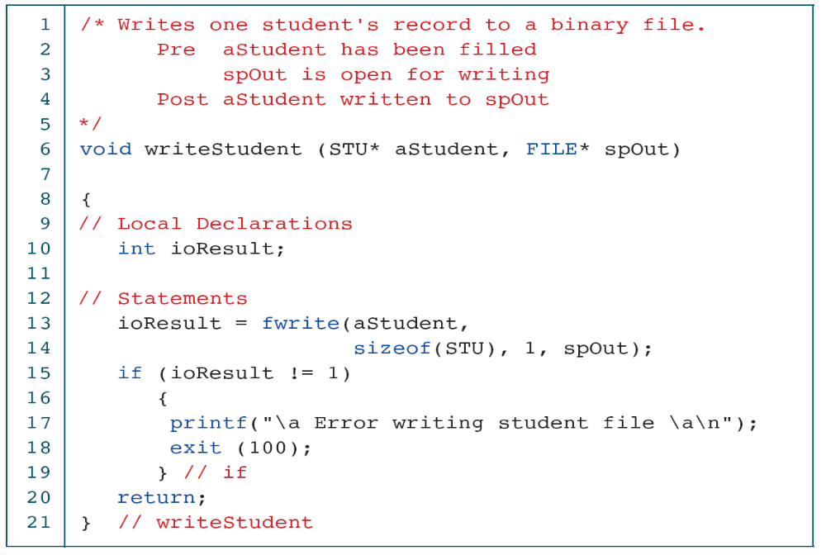
PROGRAM 13-3
Write Structured Data

Slide 20
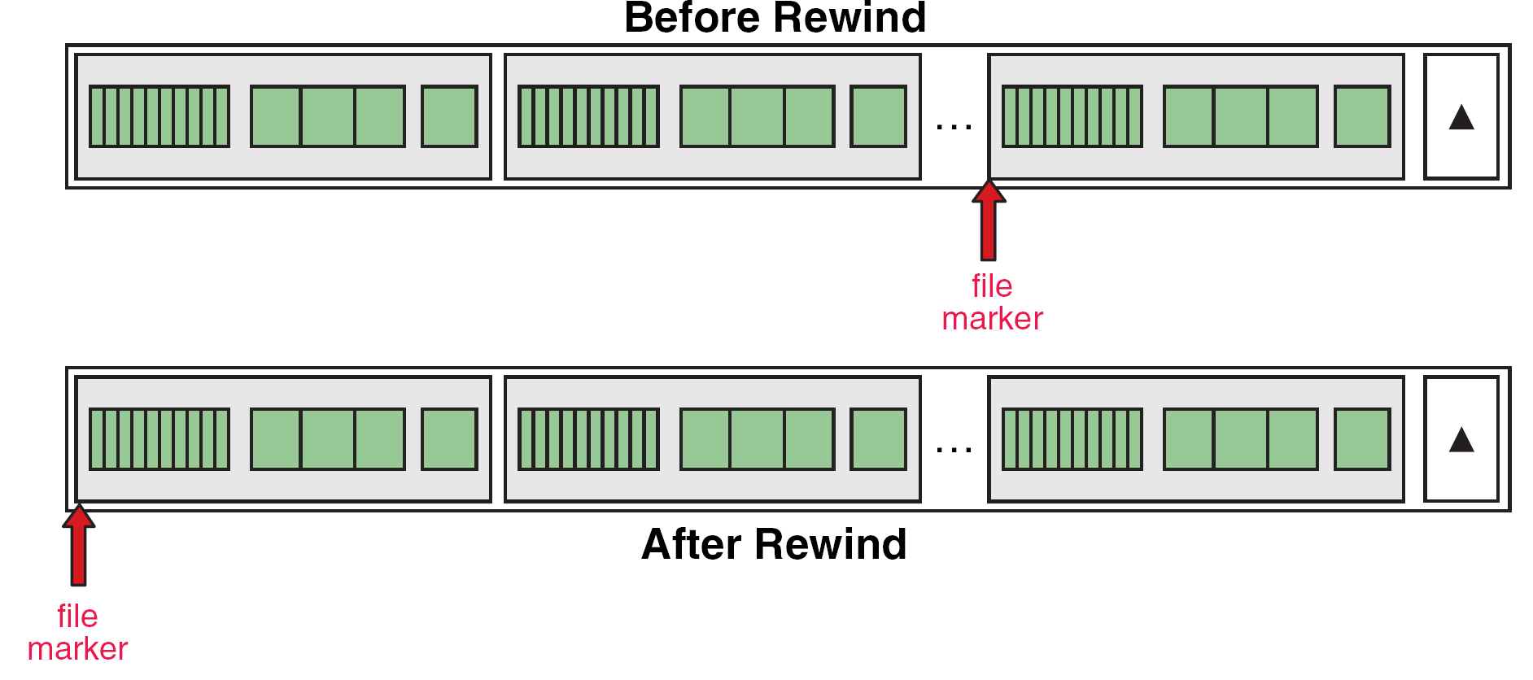
FIGURE 13-11 Rewind File

Slide 21
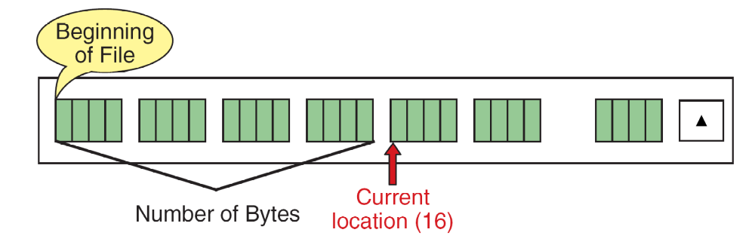
FIGURE 13-12 Current Location (ftell) Operation

Slide 22
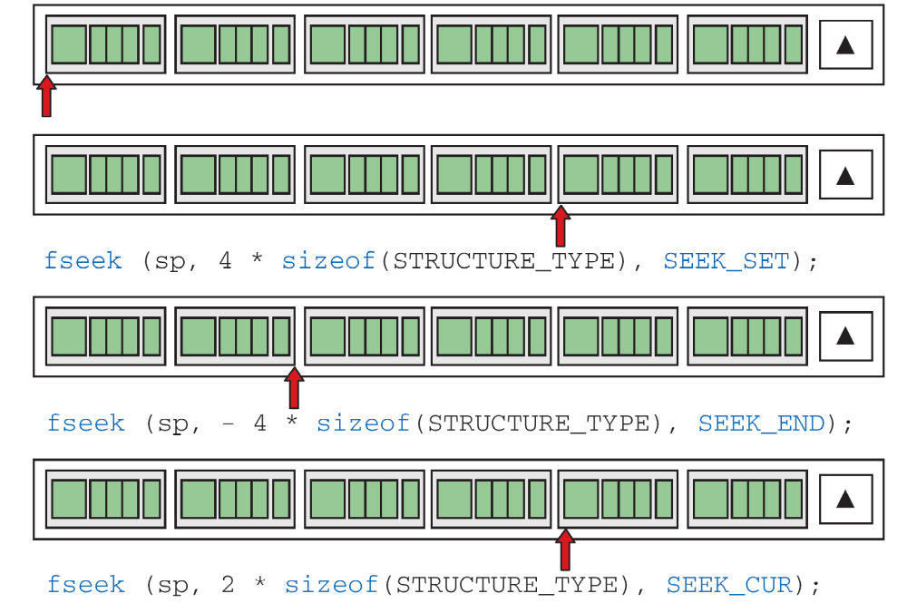
FIGURE 13-13 File Seek Operation

Slide 23
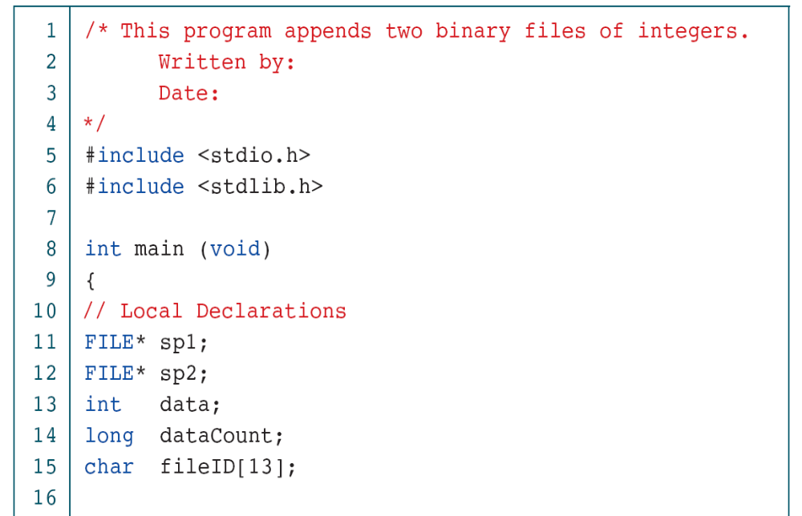
PROGRAM 13-4
Append Two Binary Files

Slide 24
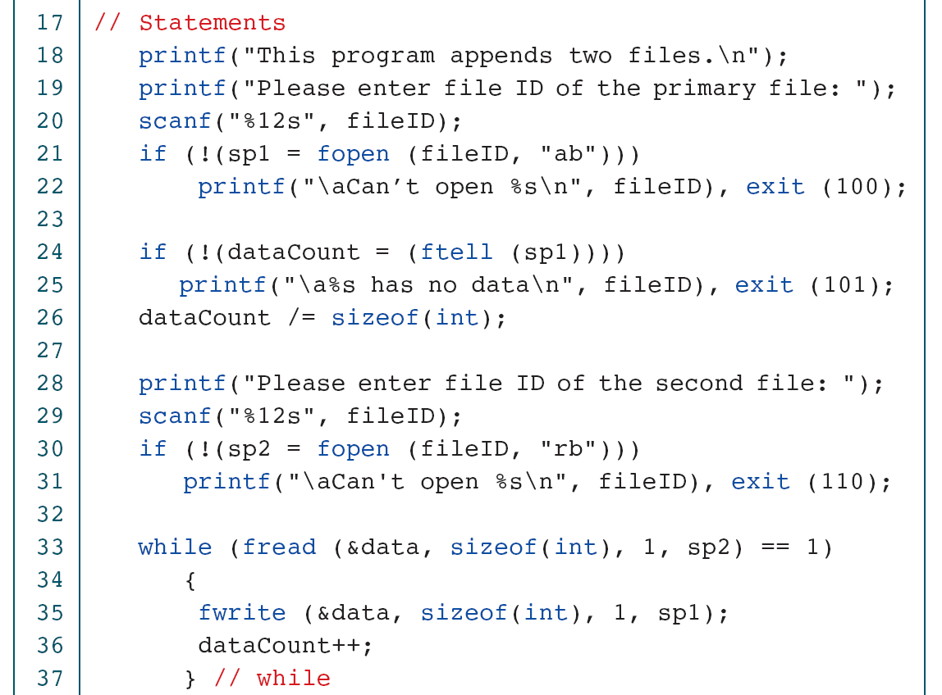
PROGRAM 13-4
Append Two Binary Files

Slide 25
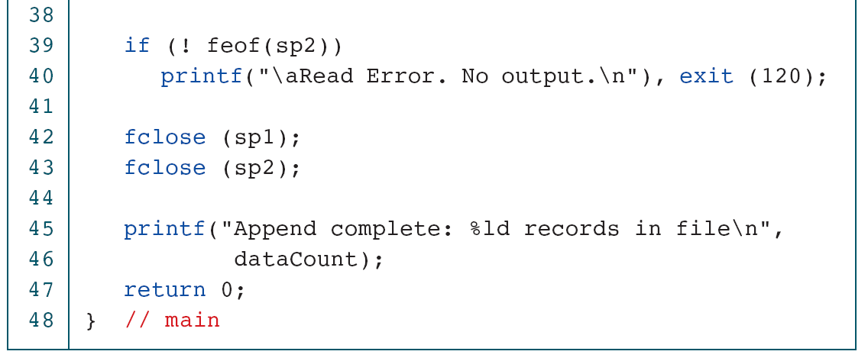
PROGRAM 13-4
Append Two Binary Files

